Slide 1
Chiba Campaign 2019 Daily? Report
Irie Laboratory Hikaru Saito(B4)

Slide 2
NO₂ by TROPOMI & 4AZ-MAXDOAS

Slide 3
United Scale(同一スケール)

Slide 4
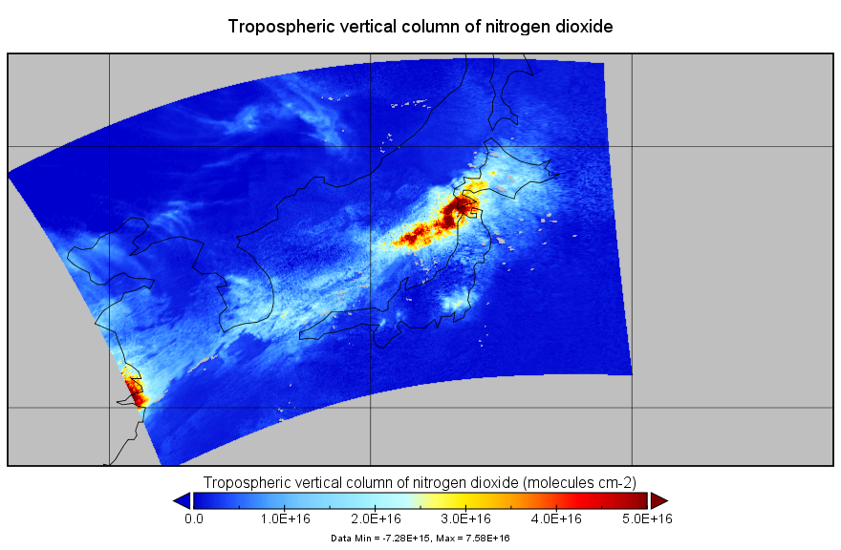
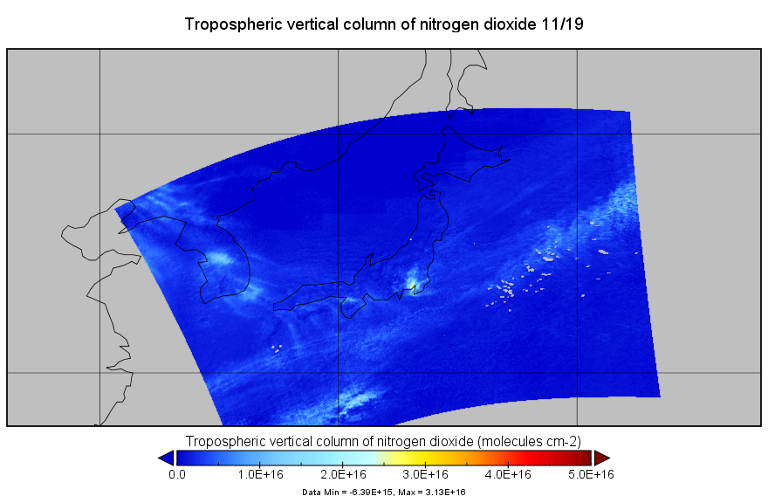
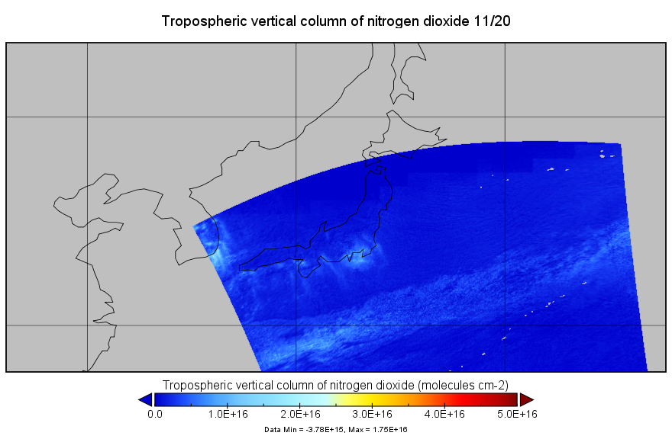
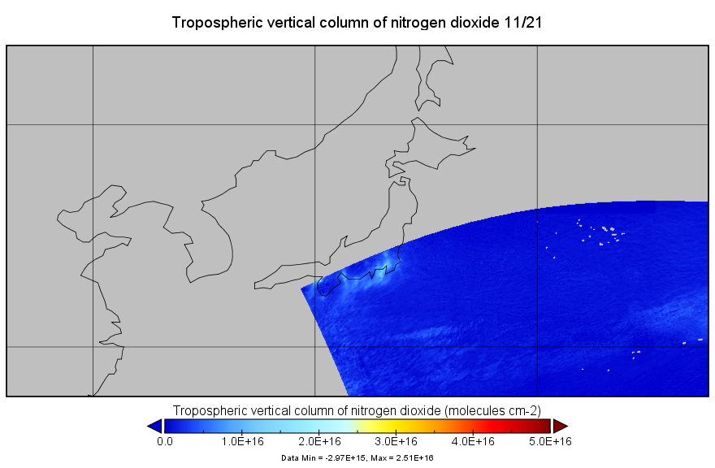
11/18

Slide 5
Individual Scale(各日異なるスケール)

Slide 6
11/18

Slide 7
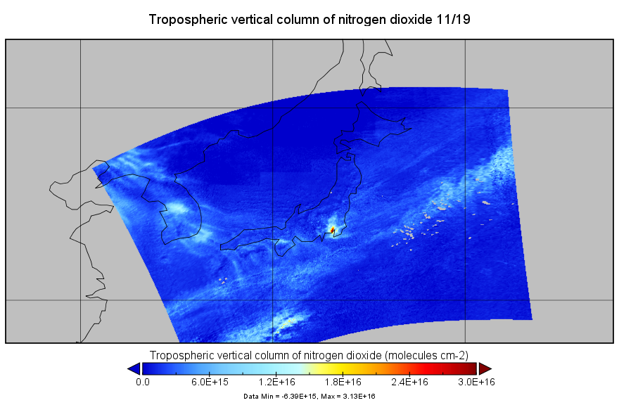

Slide 8
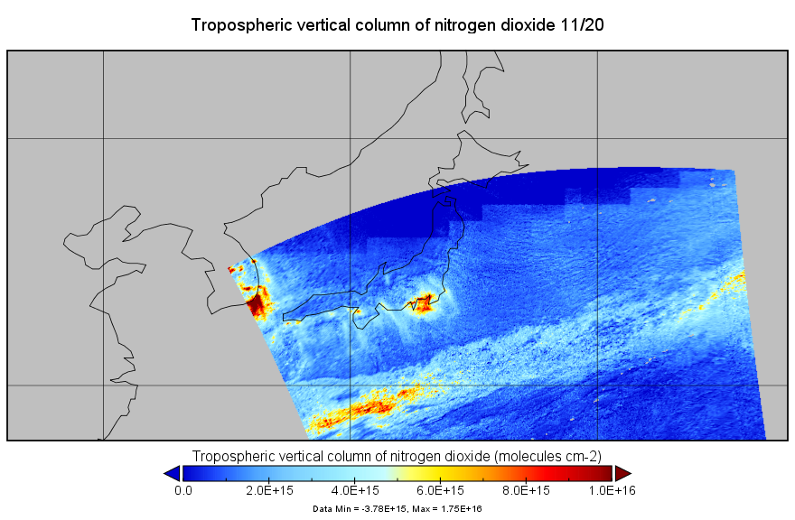

Slide 9
